Slide 1
FOOTBALL FRENZY SWEEPSTAKES
2020

Slide 2
KENTUCKY KNIGHTS OF COLUMBUS
2020 STATE PINS
$2 EACH /
3 FOR $5 /
2020 STATE PINS
Great Gift for Chaplain, Officers, Family, reward Members, etc.

Slide 3
Quick Stats from Last Year
102 Active Councils
70 Councils Participated - 68.6%
Down from 82 in 2019
38 Councils sold no tickets - 31.4%

Slide 4
2019 Total Results
The Major Fundraiser For Kentucky State Charities!
Gross Proceeds - $31,780 (-$11K under ’17)
Prizes - $ 7,000
Green Bee (Printing) $ 560
Net - $24,780
Net x 25%/75% to Green Bee / State & Councils
Equal State/Councils Split $18,585/2
Council Share/Ticket Sold $3.41 $/Ticket Sold

Slide 5
The Fundraiser Basics
Tickets are $10.00 each & the customer is eligible for membership in the Green Bee Savings Club
This membership allows access to Restaurant.com for gift certificate offers such as: Get $25 certificates for $5.00
Save at over 18,000 restaurants Nationwide
Along with other offers
But you have to register.
Go to www.greenbeesavingsclub.com

Slide 6
The Fundraiser Basics
The first 700 Tickets Generate $7,000 in Prize Money
Expenses are then subtracted.
Thereafter the proceeds from each ticket is equally divided between the state and the selling council
If each member in your council buys one ticket you have a very successful fund raiser.
Sell at least 25 tickets and get 25 State Deputy Award Points
A full accounting will be reported at the 2021 State Convention.
Checks will be mailed to Councils after all bills are paid. *note: Checks paid out are rounded to nearest $*

Slide 7
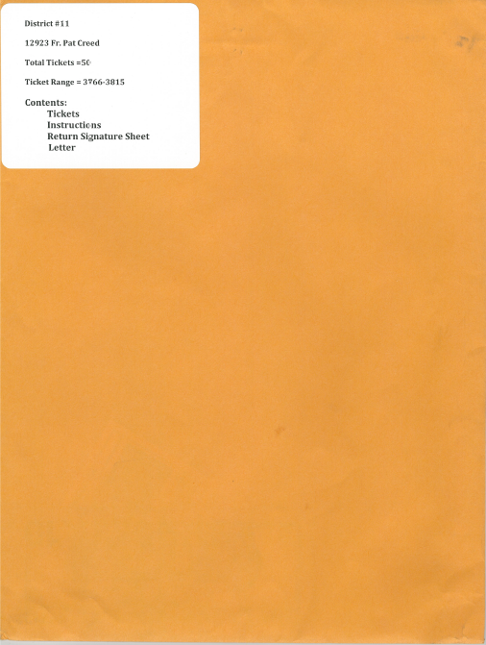
Council Packets

Slide 8
Return Envelope

Slide 9
Council Packet Contents

Slide 10
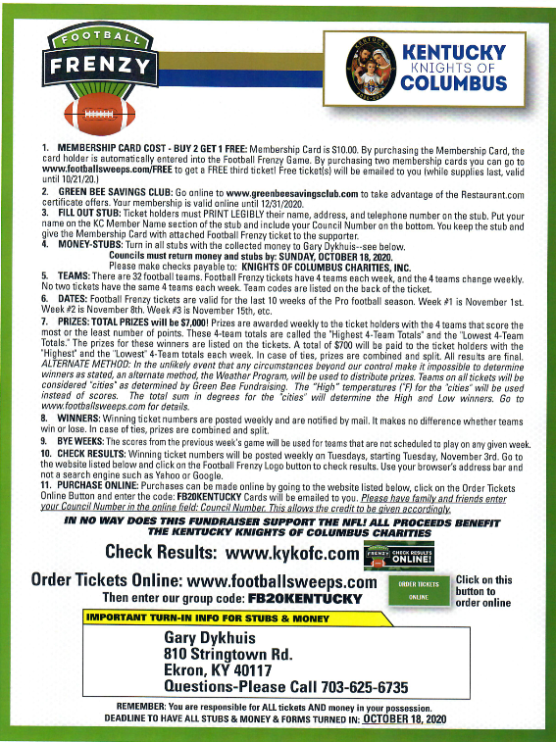
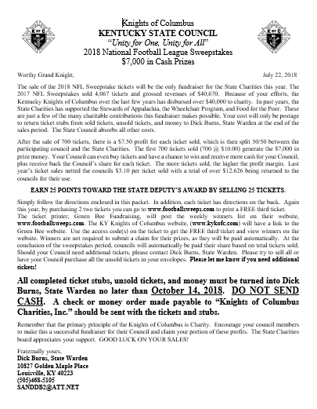
Council Packet Contents

Slide 11
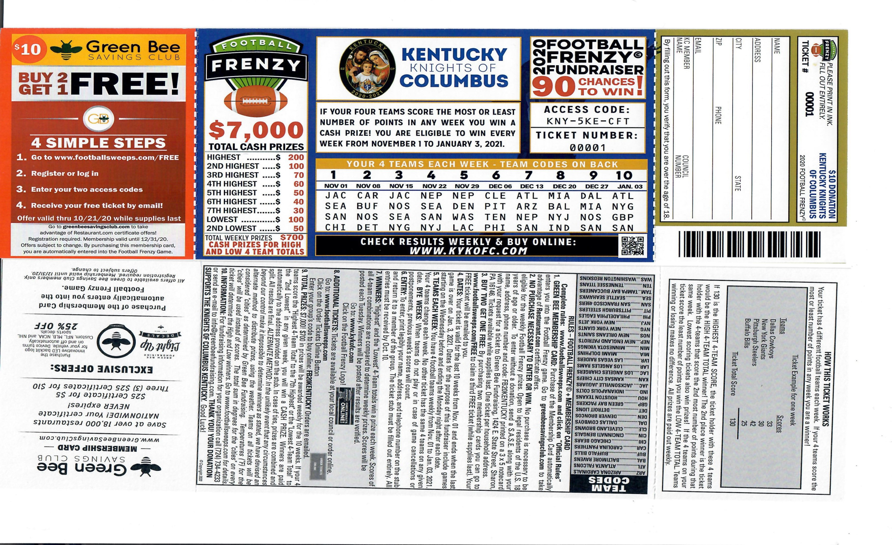
Council Packet Contents

Slide 12
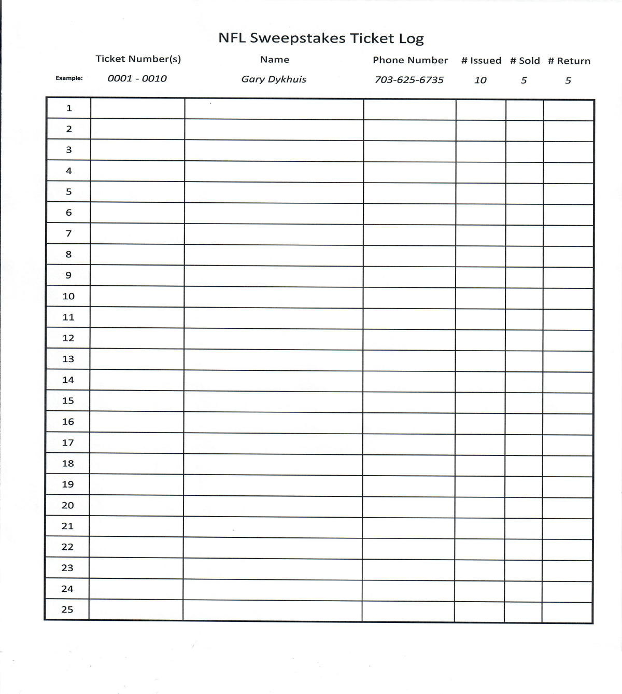
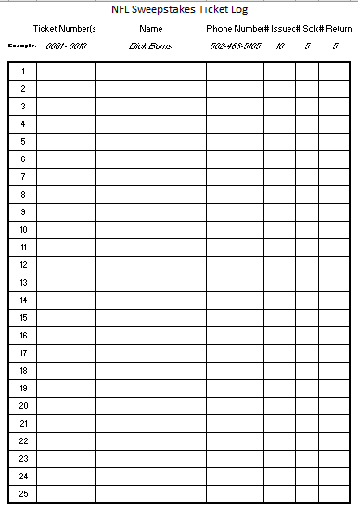
Council Packet Contents

Slide 13
Bonus - Poster
Don’t forget to take a poster with you for promoting your council sweepstakes ticket sales- available at the sweepstakes distribution table

Slide 14
Directions
Fill Out Ticket Stub
Customer’s Name
Address
Telephone Number
You Keep Completed Stub & You Collect $10.00 per Ticket
Customer Keeps Ticket
Ticket valid for 10 Weeks of the NFL Season
Week 1 – November 1, 2020
Week 10 – January 3, 2021

Slide 15
Directions for Buy 2 Get 1 Free
4 Simple Steps
Go to www.footballsweeps.com/FREE
Register or Log In
Enter your two access codes
Receive your free ticket by email
NOTE
This offer valid until 10/21/20

Slide 16
Directions
Turn in Everything:
Stubs
Donations
Unsold Tickets.
To: Gary Dykhuis
810 Stringtown Road
Ekron, KY 40117
703-625-6735
Mail Returns Early

Slide 17
Directions
ALL Stubs and Donations must be
in State Warden's Possession by
October 18, 2020
WHY: So that the tickets can be Entered Into the System…So that the purchaser has a chance to win!
Mail Returns Early

Slide 18
Directions
Please: DO NOT SEND CASH
MAKE CHECKS or MONEY ORDER PAYABLE TO:
“Knights of Columbus Charities, Inc.”

Slide 19
Directions
You can check results on-line at
www.kykofc.com
Click on the Football Frenzy Logo

Slide 20
Directions
If Your Council Needs More Tickets Contact:
Gary Dykhuis
KY State Warden
703-625-6735
gdykhuis@bbtel.com

Slide 21
Main Points to Remember
Please encourage every council member to make this a successful fundraiser for their council.
$3+/Ticket Sold last year WENT BACK TO THE PARTICIPATING COUNCILS
Earn 25 points towards State Deputy Award for selling at least 25 tickets.
Buy two get one free is available
Don’t forget to take a poster with you for promotional help
RETURN YOUR PACKAGES TO GARY DYKHUIS BY OCTPBER 13!!!!

Slide 22
The State Charities Board appreciates your support of this Kentucky State Charities Fundraiser.

